Slide 1

Topic: Floor Plan Generation Using ML
Indian Institute of Technology, Guwahati.
Name : Shrijeet Gaikwad
Roll Number: 224104421
Literature Review Progress Meeting 1

Slide 2
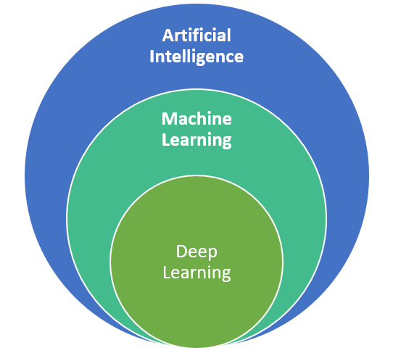
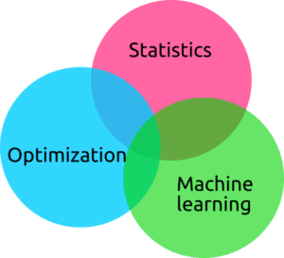
Topic to explore
Neural Network
Decisions
Weight Functions to decisions
Activation function
Deep Neural Network
And hence,
Deep Learning

Slide 3
Literatures:
Maksimova, Julie (2022). Through the eyes of a machine Mapping and comparing building floor plans using unsupervised machine learning. Scopus: 2-s2.0-85145550749
Lu Y at al. (2021) . CUBIGRAPH5K: Organizational graph generation for structured architectural floor plan dataset. doi:10.52842/conf.caadria.2021.1.081
Bayer, Johannes et al. (2018) Floor Plan Generation and Auto Completion Based on Recurrent Neural Networks. D.oi:10.1109/ICDAR.2017.272
Karthik, K. (2022). An Efficient Floor Plan Classification with Optimized Image Features using Machine. doi: 10.1109/INDICON56171.2022.10039830
Laignel, Graziella (2021).Floor plan generation through a mixed constraint programming-genetic optimization approach. doi: 10.1016/j.autcon.2020.103491

Slide 4
1. Conference Proceeding (Proceeding of the 13th space syntax)
Aim:
Methodology
Conclusion:
Mapping and comparing building floor plans using unsupervised machine learning.
They are using two different dataset generative algorithms viz. SOM and VAE.
For image recognition, CNN.
ML with supervised and unsupervised network algorithms
67.9% - supervised Learning.
85%-Unsupervised Learning.

Slide 5
2. Organizational graph generation for structured architectural floor plan dataset
Aim:
Methodology
Conclusion:
provide a matching dataset that could be used to train neural networks on enhanced floor plan parsing, analysis and generation in future research
Generation model CubiGraph5k from existing CubiCasa5K. Different from other GANs
Graph Theory. (Supervised Learning)
Low Short Term Memory (LSTM) Neural Network. Best for graphical inputs.
68% of the graph generated correctly reflected the original floor plan. Error due to labelling mistakes from CubiCasa5K
Definition of room relations didn’t take cross-level connections into account thus it only works for single-level floor plan.
Extracts the geometrical info from floorplans and generate a graph representation based in room relation.

Slide 6
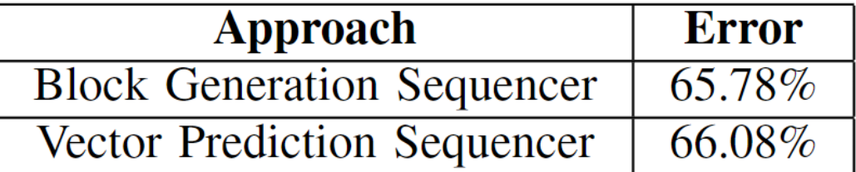
3. Proceedings of the International Conference on Document Analysis and Recognition, ICDAR (2018)
Aim:
Methodology
Conclusion:
Floor Plan Generation and Auto Completion Based on Recurrent Neural Networks
.
Long-Short Term Memories are a class of recurrent artificial neural networks.(RNN)
Depending Upon the tags like room definition ,connection and room layout tags. This produces a feature vector.
LSTM run via sequencer- block generation sequencer and Vector Prediction Sequencers

Slide 7
4. Floor plan generation through a mixed constraint programming-genetic optimization approach
Aim:
Methodology
Conclusion:
automatic apartment floor layout generation
.page 18
Optimizer algorithm generates several floor plans aiming at both architectural and functional constraints
DL methods are based on existing datasets which are not easy to collect and which may induce an architectural bias and they only deal with rectilinear plans
Process includes
Grid Generation
Room placement throught constraint programming
Layout selection

Slide 8
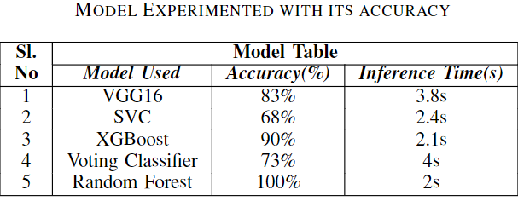
5. INDICON 2022 - 2022 IEEE 19th India Council International Conference
Aim:
Methodology
Conclusion:
An Efficient Floor Plan Classification with Optimized Image Features using Machine Learning
.
Classify Floor Plan Uses SIFT and SURF algorithm.
Ultimately CNNs
Dataset used: CubiCasa5k

Slide 9
Bird Eye View
LITERATURE | MEMETHODOLOGY
1. Mapping and comparing building floor plans | DL
2. Organizational graph generation for structured architectural floor plan dataset | Graph theory LSTM Model
3. Floor Plan Generation and Auto Completion Based on Recurrent Neural Networks | RNN
4. Floor plan generation through a mixed constraint programming-genetic optimization approach | Optimizer Algorithm
5. An Efficient Floor Plan Classification with Optimized Image Features using Machine Learning | ML

